Slide 1
Operating System Services
Prepared By
Dr. Vikas Lamba
Chitkara University Institute of Engineering and Technology,
Chitkara University, Punjab

Slide 2
Content
Operating System Services
User Operating System Interface
System Calls
Types of System Calls
System Programs
Notes:
2

Slide 3
Operating System Services
Operating systems provide an environment for execution of programs and services to programs and users
One set of operating-system services provides functions that are helpful to the user:
User interface - Almost all operating systems have a user interface (UI).
Varies between Command-Line (CLI), Graphics User Interface (GUI), Batch Interface
Program execution - The system must be able to load a program into memory and to run that program, end execution, either normally or abnormally (indicating error)
I/O operations - A running program may require I/O, which may involve a file or an I/O device
Notes:
3

Slide 4
Operating System Services (Cont.)
One set of operating-system services provides functions that are helpful to the user (Cont.):
File manipulation - The file system is of particular interest. Programs need to read and write files and directories, create and delete them, search them, list file Information, permission management.
Communications – Processes may exchange information, on the same computer or between computers over a network
Communications may be via shared memory or through message passing (packets moved by the OS)
Error detection – OS needs to be constantly aware of possible errors
May occur in the CPU and memory hardware, in I/O devices, in user program
For each type of error, OS should take the appropriate action to ensure correct and consistent computing
Debugging facilities can greatly enhance the user’s and programmer’s abilities to efficiently use the system
Notes:
4

Slide 5
Operating System Services (Cont.)
Another set of OS functions exists for ensuring the efficient operation of the system itself via resource sharing
Resource allocation - When multiple users or multiple jobs running concurrently, resources must be allocated to each of them
Many types of resources - CPU cycles, main memory, file storage, I/O devices.
Accounting - To keep track of which users use how much and what kinds of computer resources
Protection and security - The owners of information stored in a multiuser or networked computer system may want to control use of that information, concurrent processes should not interfere with each other
Protection involves ensuring that all access to system resources is controlled
Security of the system from outsiders requires user authentication, extends to defending external I/O devices from invalid access attempts
Notes:
5

Slide 6
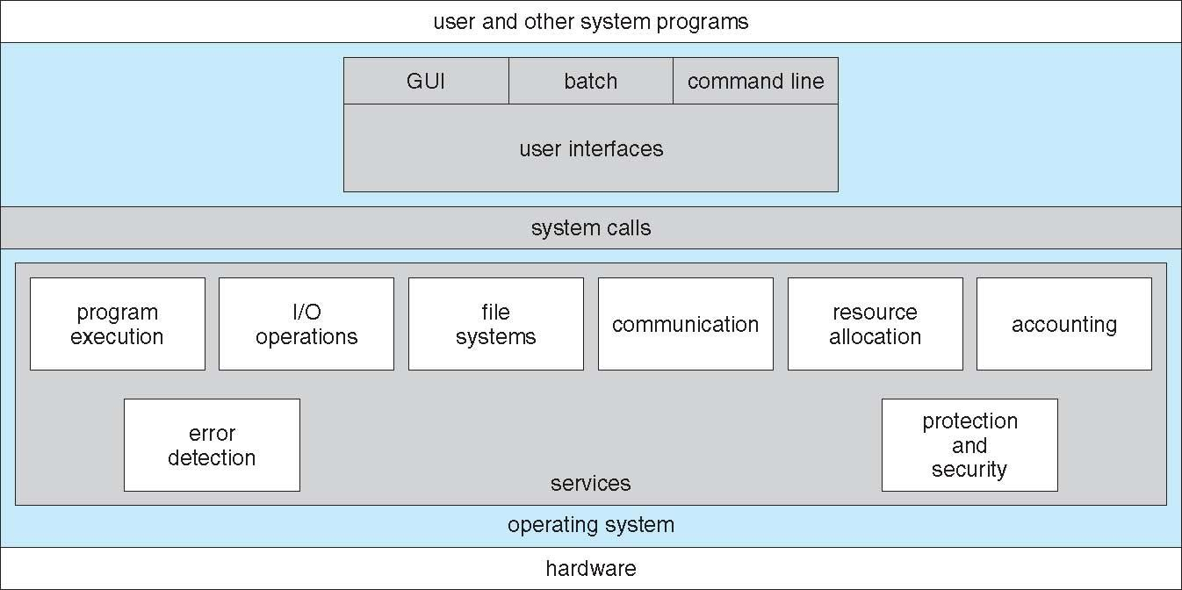
A View of Operating System Services

Slide 7
User Operating System Interface - CLI
CLI or command interpreter allows direct command entry
Sometimes implemented in kernel, sometimes by systems program
Sometimes multiple flavors implemented – shells
Primarily fetches a command from user and executes it
Sometimes commands built-in, sometimes just names of programs
If the latter, adding new features doesn’t require shell modification
Notes:
7

Slide 8
User Operating System Interface - GUI
User-friendly desktop metaphor interface
Usually mouse, keyboard, and monitor
Icons represent files, programs, actions, etc
Various mouse buttons over objects in the interface cause various actions (provide information, options, execute function, open directory (known as a folder)
Invented at Xerox PARC
Many systems now include both CLI and GUI interfaces
Microsoft Windows is GUI with CLI “command” shell
Apple Mac OS X is “Aqua” GUI interface with UNIX kernel underneath and shells available
Unix and Linux have CLI with optional GUI interfaces (CDE, KDE, GNOME)
Notes:
8

Slide 9
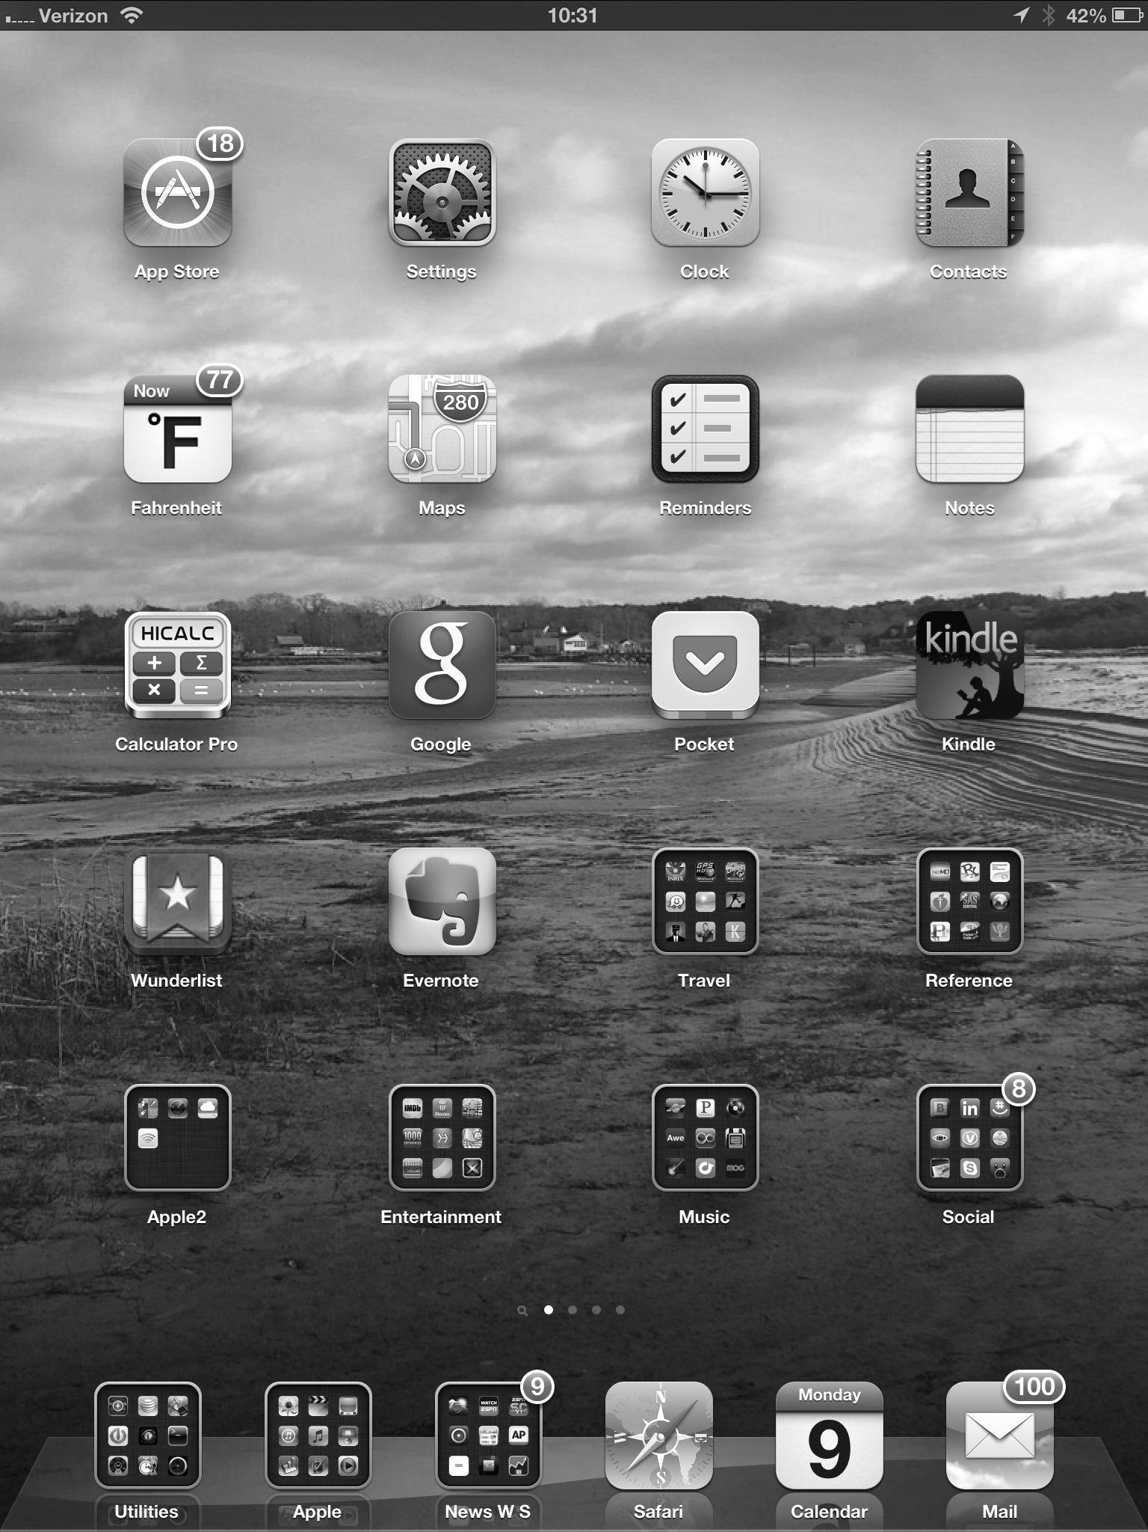
Touchscreen Interfaces
Touchscreen devices require new interfaces
Mouse not possible or not desired
Actions and selection based on gestures
Virtual keyboard for text entry
Voice commands.
Notes:
9

Slide 10
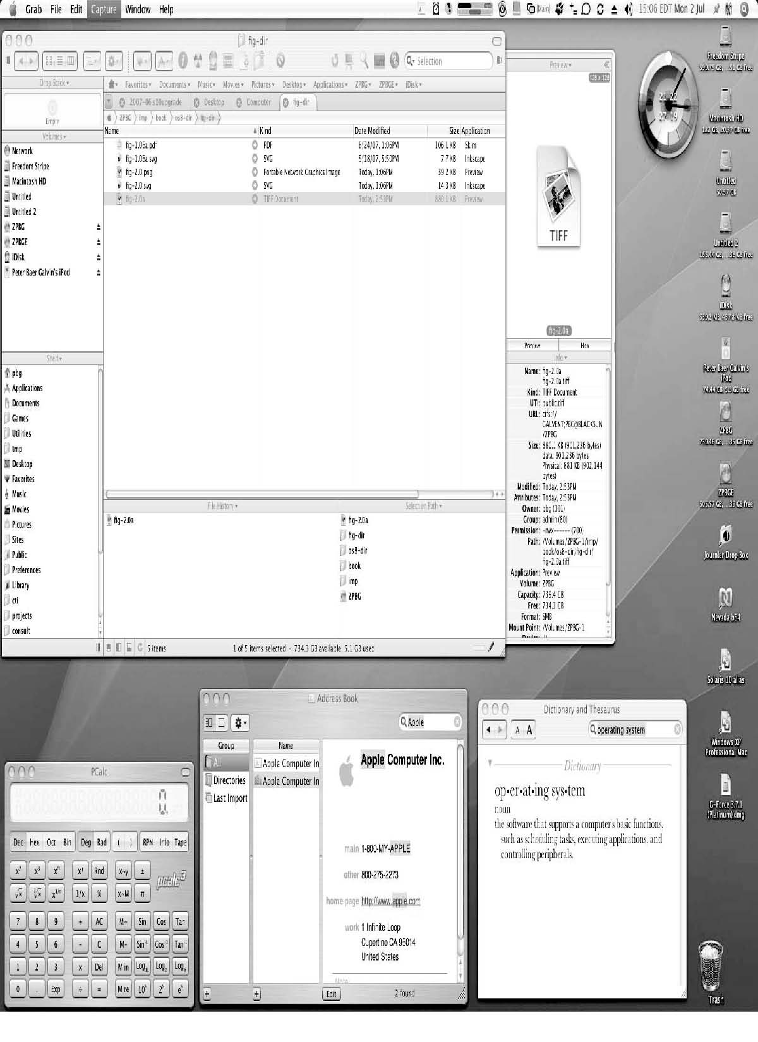
The Mac OS X GUI

Slide 11
System Calls
System calls are mechanism or programs those runs in OS(Shell) to provide the OS services (from kernel)
By using System calls we access the OS services
Typically written in a high-level language (C or C++)
Mostly system calls are performed by high level programs Application Programming Interface (API) rather than direct system call use.
Three most common APIs are Win32 API for Windows, POSIX API for POSIX-based systems (including virtually all versions of UNIX, Linux, and Mac OS X), and Java API for the Java virtual machine (JVM)
Notes:
11

Slide 12
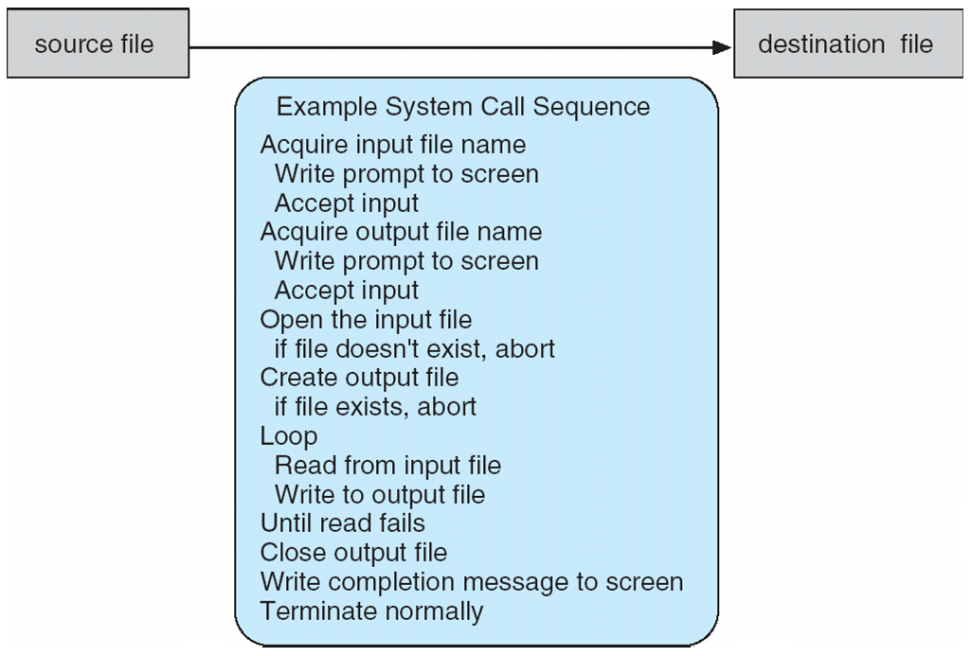
Example of System Calls
System call sequence to copy the contents of one file to another file
Notes:
12

Slide 13
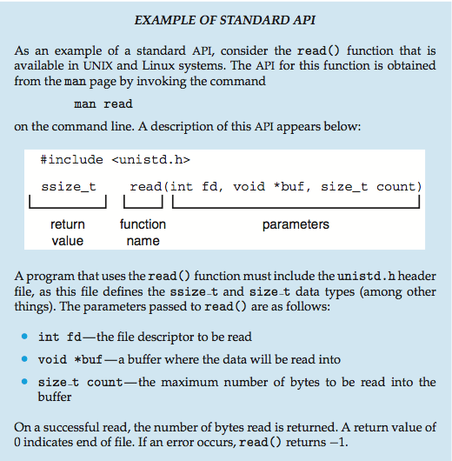
Example of Standard API
Notes:
13

Slide 14
System Call Implementation
Typically, a number associated with each system call
System-call interface maintains a table indexed according to these numbers
The system call interface invokes the intended system call in OS kernel and returns status of the system call and any return values
The caller need know nothing about how the system call is implemented
Just needs to obey API and understand what OS will do as a result call
Most details of OS interface hidden from programmer by API
Managed by run-time support library (set of functions built into libraries included with compiler)
Notes:
14

Slide 15
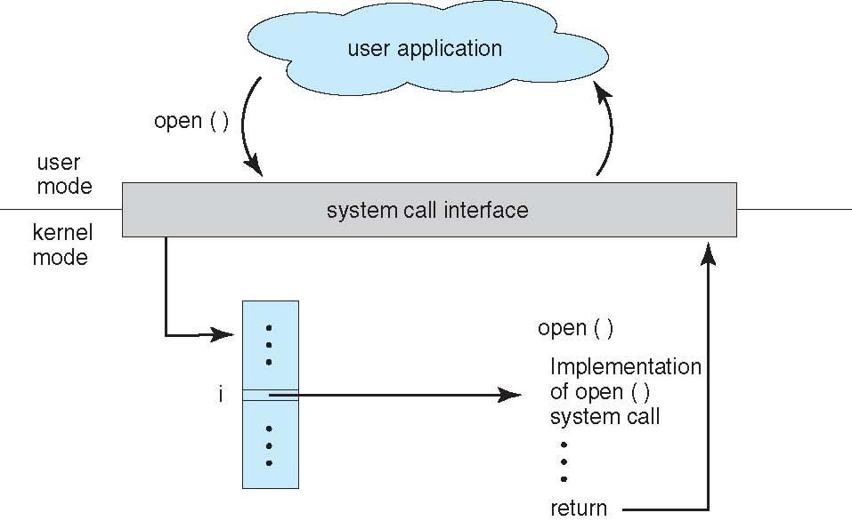
API – System Call – OS Relationship
Notes:
15

Slide 16
System Call (as parameter passing)
Often, more information is required than simply identity of desired system call
Exact type and amount of information vary according to OS and call
Three general methods used to pass parameters to the OS
Simplest: pass the parameters in registers
In some cases, may be more parameters than registers
Parameters stored in a block, or table, in memory, and address of block passed as a parameter in a register
This approach taken by Linux and Solaris
Parameters placed, or pushed, onto the stack by the program and popped off the stack by the operating system
Block and stack methods do not limit the number or length of parameters being passed
Notes:
16

Slide 17
Types of System Calls
Process (Program execute) control
create process, terminate process
end, abort
load, execute
get process attributes, set process attributes
wait for time
wait event, signal event
allocate and free memory
Dump memory if error
Debugger for determining bugs, single step execution
Locks for managing access to shared data between processes
Notes:
17

Slide 18
Types of System Calls
File management
create file, delete file
open, close file
read, write, reposition
get and set file attributes
Device management
request device, release device
read, write, reposition
get device attributes, set device attributes
logically attach or detach devices
Notes:
18

Slide 19
Types of System Calls (Cont.)
Information maintenance
get time or date, set time or date
get system data, set system data
get and set process, file, or device attributes
Communications
create, delete communication connection
send, receive messages if message passing model to host name or process name
From client to server
Shared-memory model create and gain access to memory regions
transfer status information
attach and detach remote devices
Notes:
19

Slide 20
Types of System Calls (Cont.)
Protection
Control access to resources
Get and set permissions
Allow and deny user access
Notes:
20

Slide 21
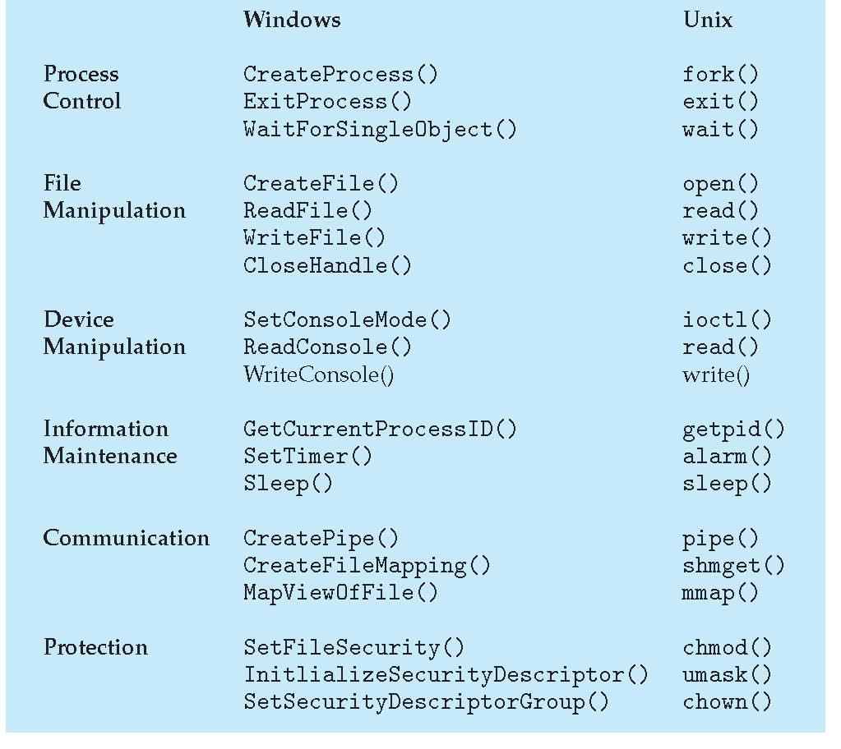
Examples of Windows and Unix System Calls

Slide 22
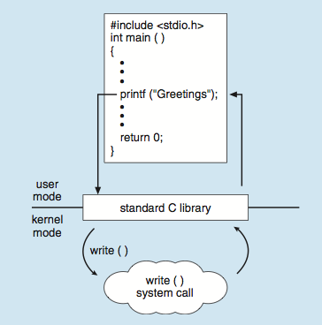
Standard C Library Example
C program invoking printf() library call, which calls write() system call
Notes:
22

Slide 23
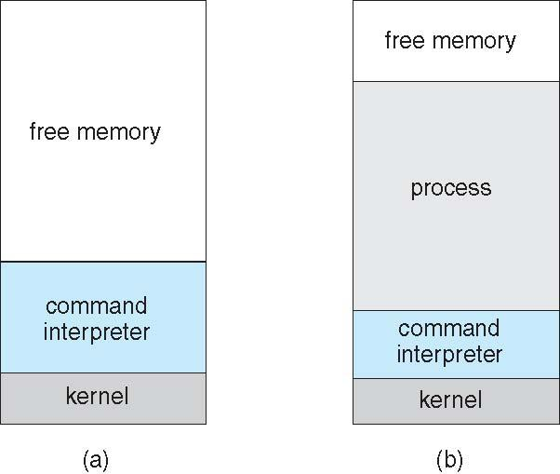
Example: MS-DOS
Single-tasking
Shell invoked when system booted
Simple method to run program
No process created
Single memory space
Loads program into memory, overwriting all but the kernel
Program exit -> shell reloaded
At system startup running a program

Slide 24
System Programs
System programs provide a convenient environment for program development and execution. They can be divided into:
File manipulation (programs or commands)
Status information sometimes stored in a File modification programs or commands
Programming language support (programs or commands)
Program loading and execution (programs or commands)
Communications
Background services (programs or commands)
Application programs (programs or commands)
Most users’ view of the operation system is defined by system programs, not the actual system calls
Notes:
24

Slide 25
System Programs
Provide a convenient environment for program development and execution
Some of them are simply user interfaces to system calls; others are considerably more complex
File management - Create, delete, copy, rename, print, dump, list, and generally manipulate files and directories (Commands in DOS and Linux)
Status information
Some ask the system for info - date, time, amount of available memory, disk space, number of users
Others provide detailed performance, logging, and debugging information
Typically, these programs format and print the output to the terminal or other output devices
Some systems implement a registry - used to store and retrieve configuration information
Notes:
25

Slide 26
System Programs (Cont.)
File modification
Text editors to create and modify files
Special commands to search contents of files or perform transformations of the text.
Programming-language support - Compilers, assemblers, debuggers and interpreters sometimes provided
Process management programs – ps (display information about running process in linux), task manager in window, kill command in Linux.
Program loading and execution- Absolute loaders, relocatable loaders, linkage editors, and overlay-loaders, debugging systems for higher-level and machine language
Communications - Provide the mechanism for creating virtual connections among processes, users, and computer systems
Allow users to send messages to one another’s screens, browse web pages, send electronic-mail messages, log in remotely, transfer files from one machine to another
Networking programs- ping commang, ifconfig etc.
Notes:
26

Slide 27
System Programs (Cont.)
Background Services
Launch at boot time
Some for system startup, then terminate
Some from system boot to shutdown
Provide facilities like disk checking, process scheduling, error logging, printing
Run in user context not kernel context
Known as services, subsystems, daemons
Application programs
Don’t pertain to system
Run by users
Not typically considered part of OS
Launched by command line, mouse click, finger poke
Notes:
27

Slide 28
Thank You
Notes:
28

